Slide 2
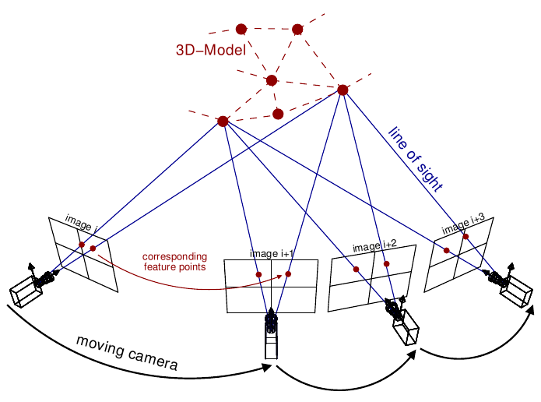
Problem
Photogrammetry is a set of techniques to get measurements from images.
It can be used to create models
Has limitations
Must have pictures all around
Neural Networks can solve this

Slide 3
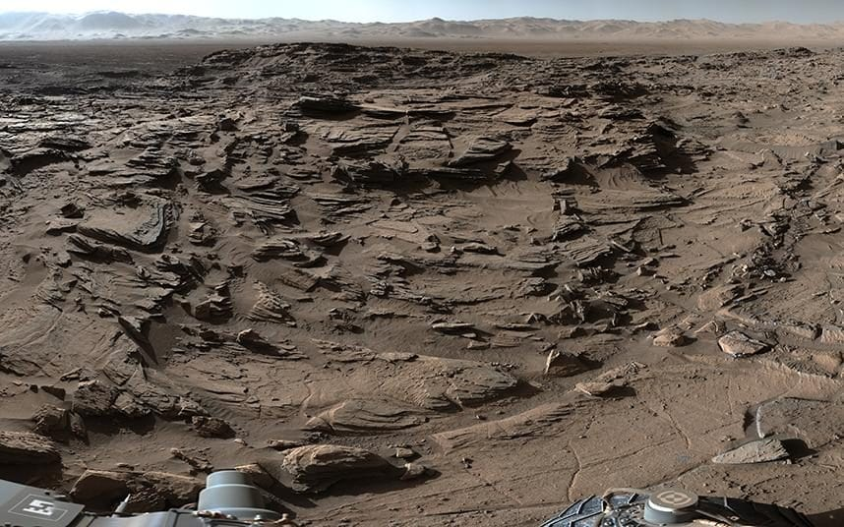
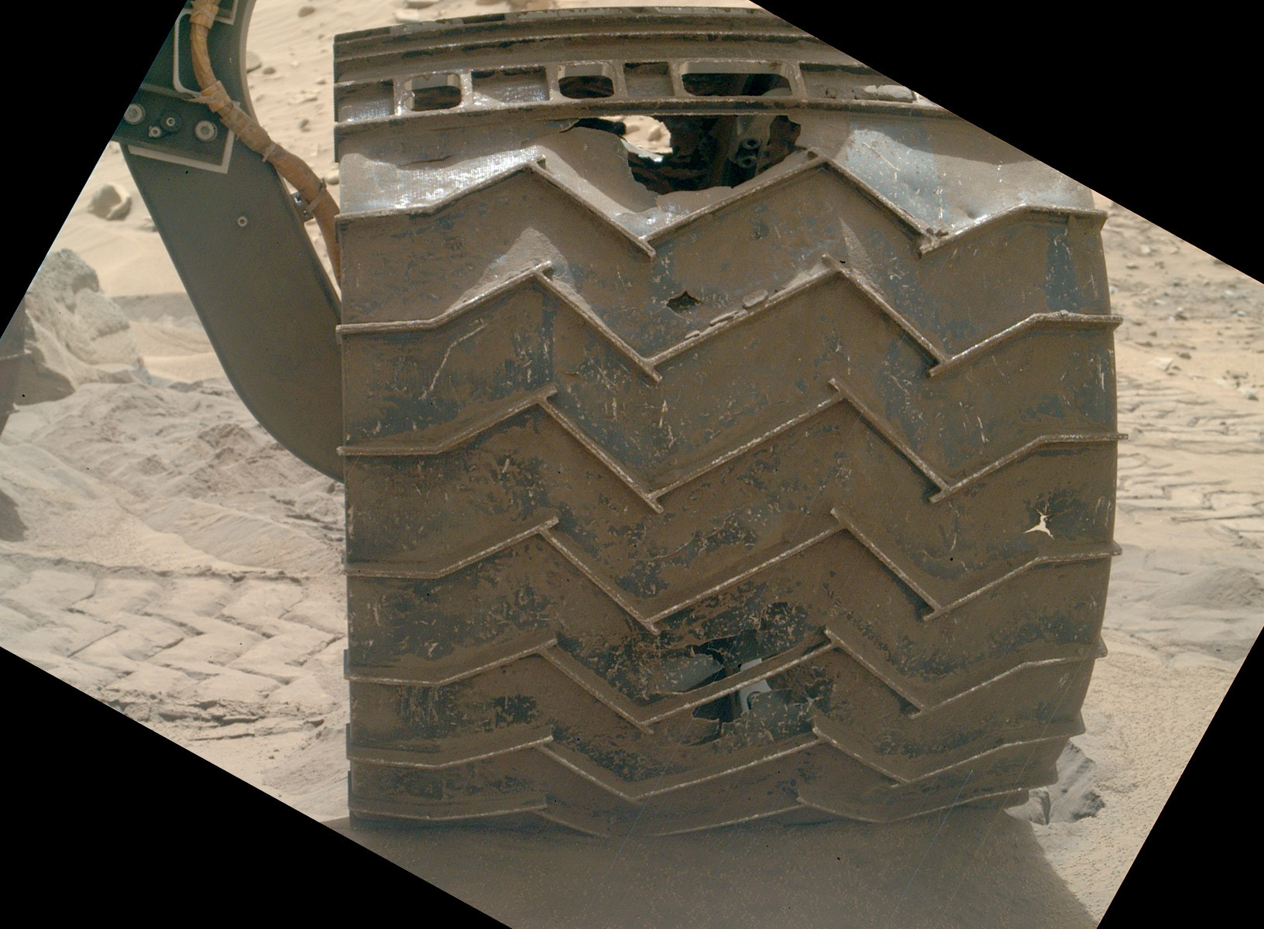
Max speed of .09 mph.
Only moved 1km in 1 year
Means its hard to do photogrammetry
Because of this lack of info, there can be significant damage

Slide 4
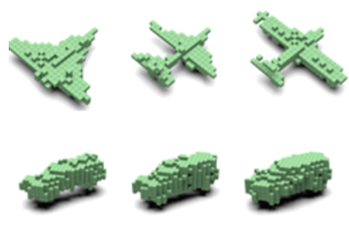

Current research
Recent research done used silhouettes to help in the creation of models.
This can work pretty well
But even it has limitations

Slide 5

Current stuff
The network failed.

Slide 6
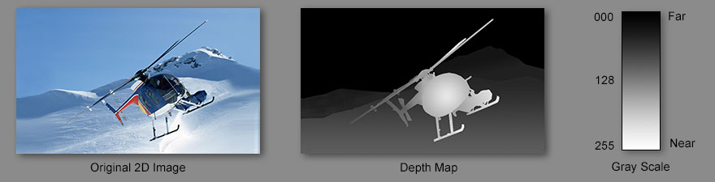
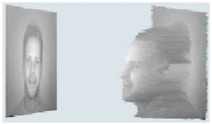
Solving the problems

Slide 7
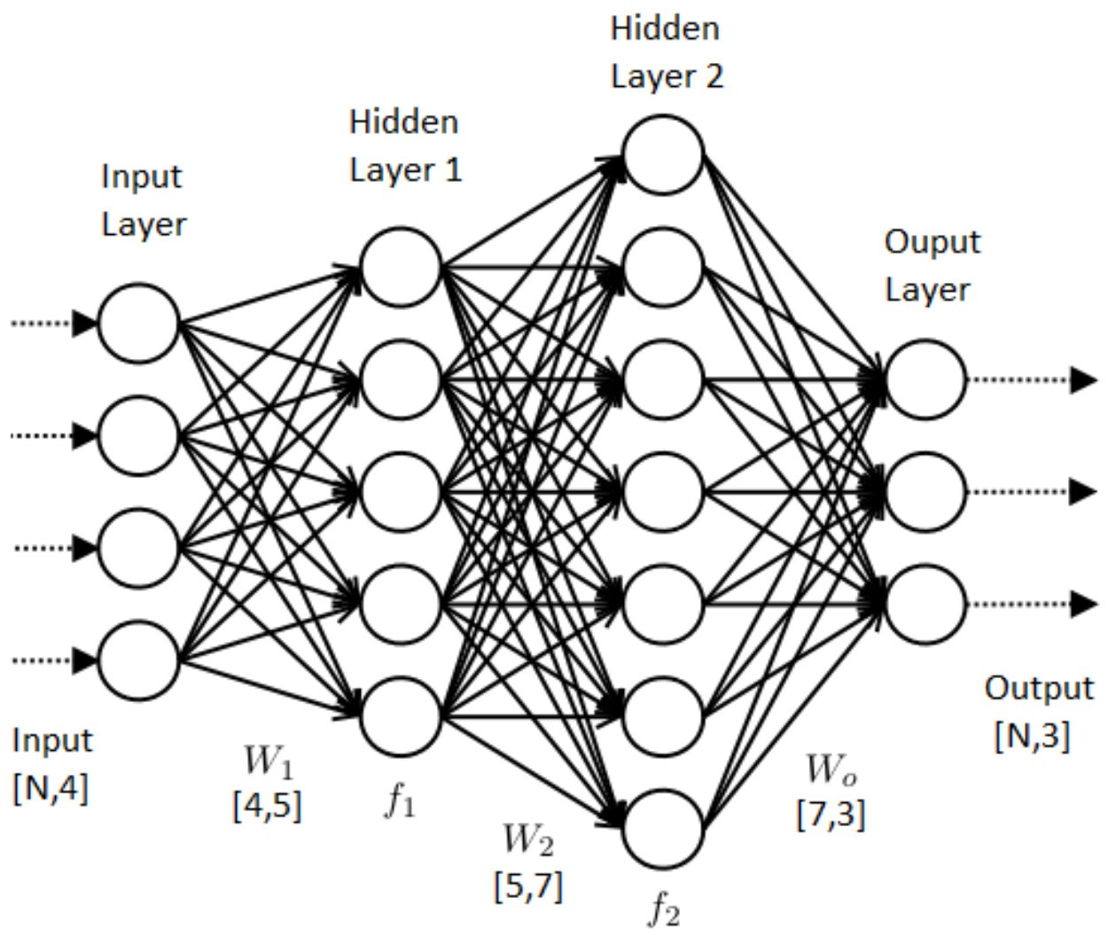
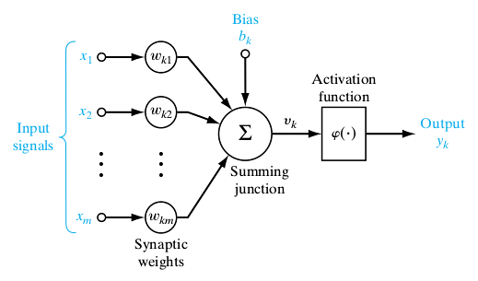
Background
So how does this network work?
Neural networks are a way of modeling datasets.
They have several advantages compared to other methods.
Many dimensions
Very generalizable
Significantly easier to create

Slide 8
Convolutional Neural Network

Slide 9
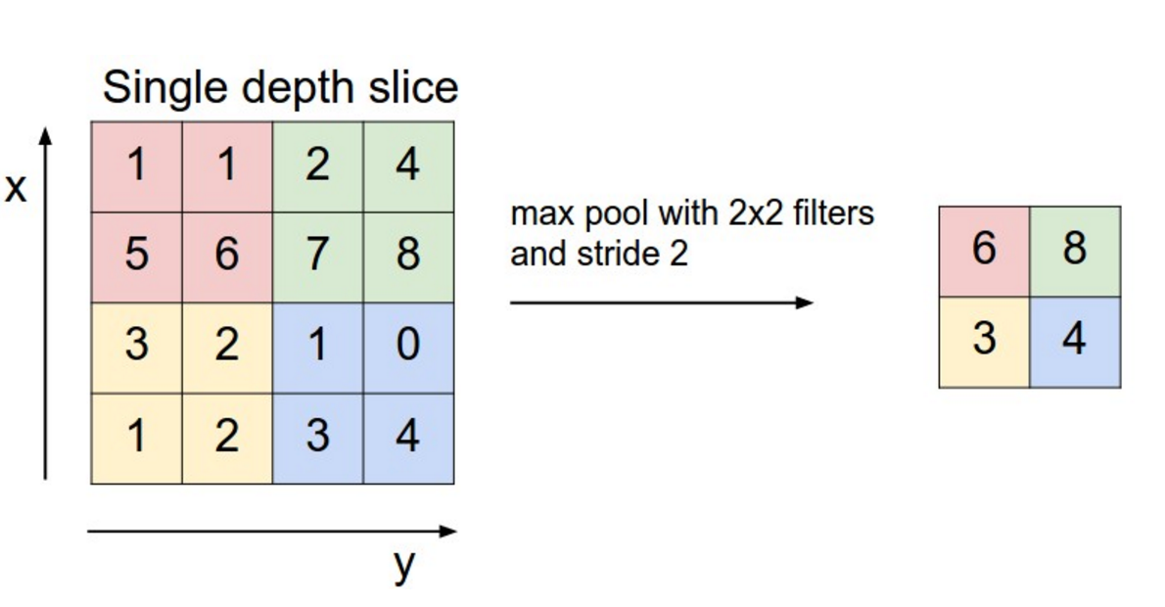
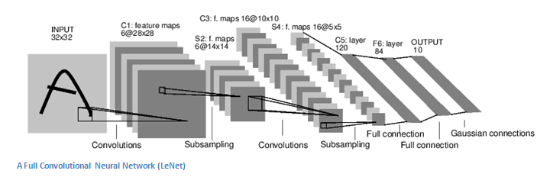

Slide 10
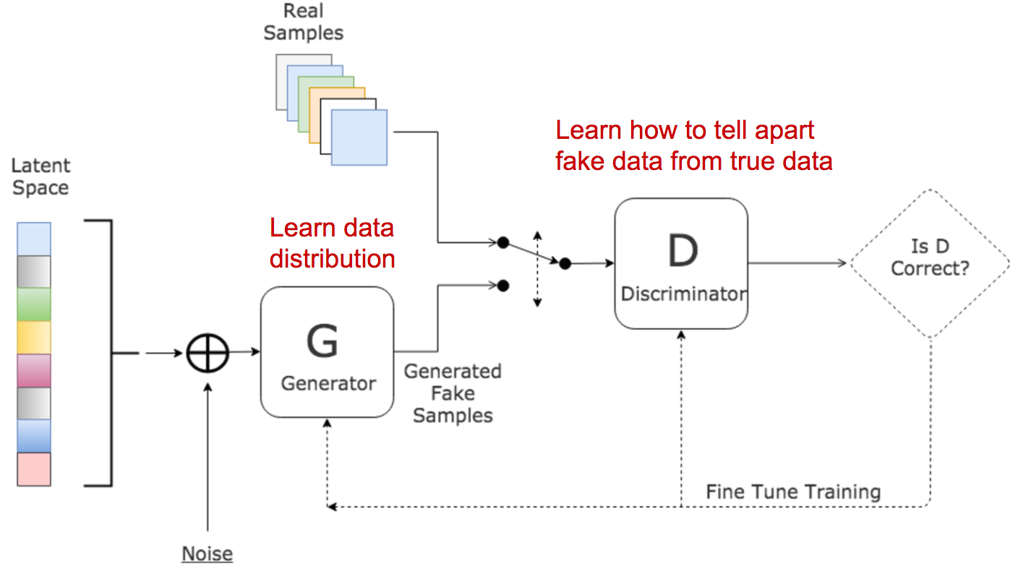
Generative Adversarial Networks

Slide 11
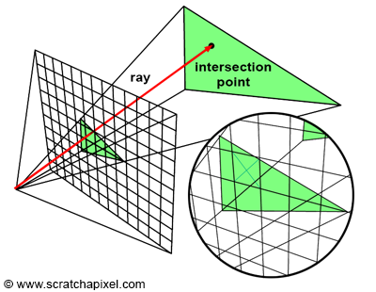
Differentiable Rendering
Is a way to create images without disrupting the training process
Helps bridge the gap between 2D and 3D

Slide 12
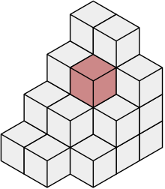

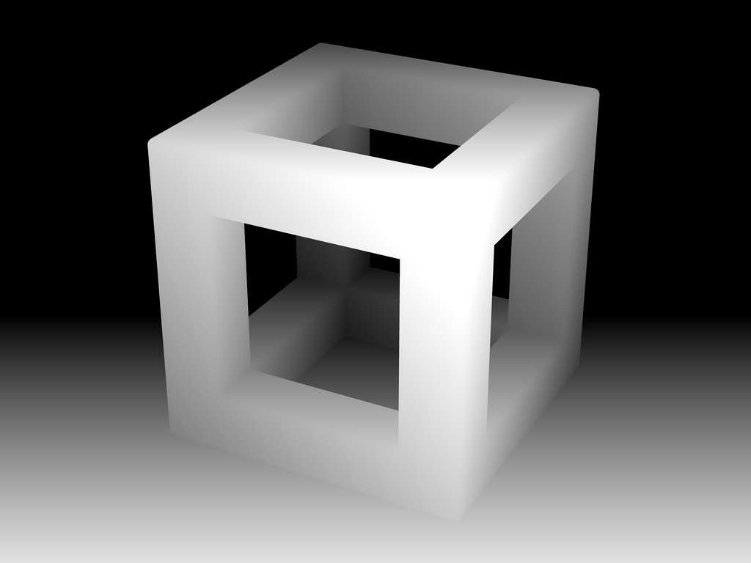
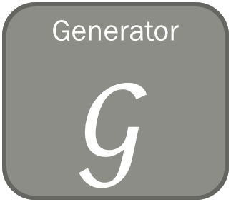

Generator$𝒢$
Discriminator
$$𝒟$$
Real or Generated?
Latent space
Output model
Training/Input Picture

Slide 13
Results/Progress

Slide 14
Workflow
Big Idea: Use GANs to generate models of objects from images
Datasets
Preprocessing
Networks
Compare output to actual model
SUN3D, ICL-NUIM RGB-D, Shapenet
Create 2D images as test input into the network
Create GAN
Evaluate using Mean Distance Error
Create depth map of object as input
Create 3D Models

